Slide 1

EDA Presentation
Virtual Internship
16/06/2023
Presented by Patryk Potocki

Slide 2


1.Introduction…(2)
2.Data Understanding…(3-4)
3.Statistical and Visual Analysis…(6-) a)Single Columns…(6-14) b)Compering of meaningful Columns to target Column.
4.Summary of findings
5.Recommendation
Page 1
Agenda

Slide 3

Introduction
Page 2
Introduction.
Welcome to today's presentation in which I will be showing you analysis and findings, related to dataset provided by you. First, I want to show you briefly what data was gathered with the survey, and then we will be able to look deeply into insights of the data to get quality information from which we will be able to look at solutions to improve market strategy for your company.

Slide 4
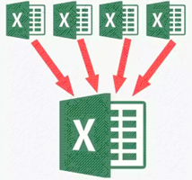
Data Understanding
Page 3
Details of Datasets.
Age_Country.csv
Education_Languages.csv
Gender_SatRate.csv
Marriage_Children.csv
Details of Master dataset.
I have merged all four datasets to get as accurate advice as possible for you.
Column name “Satisfaction rate” would be our main column to help you find better way to manage marketing strategy to be more efficient. In our data we ignore 2 Columns, Name and Email as they have no potential to give us desire insights.
Total Number:
87 Rows
10 Columns

Slide 5
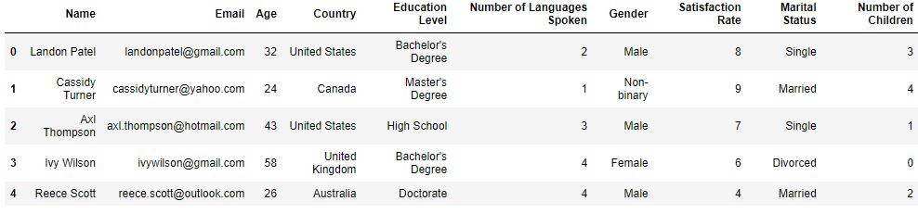
Data Understanding
Page 4
Top 5 rows and columns included in MasterData.
First, we want you to look this table which contain as mentioned in title first 5 rows, but more importantly we can see what columns we will be looking at in this presentation.

Slide 6
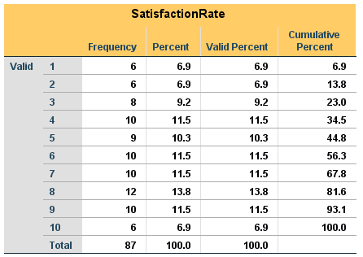
Visual and Statistical Analysis
Page 5
Additional info.
Looking at “Valid Percent”, we can confirm that our column hasn’t got any missing data as total percentage = 100, which will be the same case for each column we will be analysing.
Fig. 1
Data insights.
On Figure number 1, we can see that the highest frequency of Sat.Rate is 8 with score of 12, followed by 9/7/6/4 with a score of 10. Just after, we got rate of 5 with score of 9, then 3 with score of 8 and our last 3 rates with score of 6 are 1/2/10 which we can confirm by statistical table provided.

Slide 7
Visual and Statistical Analysis
Page 6
Frequency of participant per Age.
In our next step we are looking at Age column frequency of surveyed. As we can see the participant in survey are in group age from 20-61 years old, but to get deeper insight from this column we need to move on to the statistical table. (See page 7)
Fig. 2

Slide 8
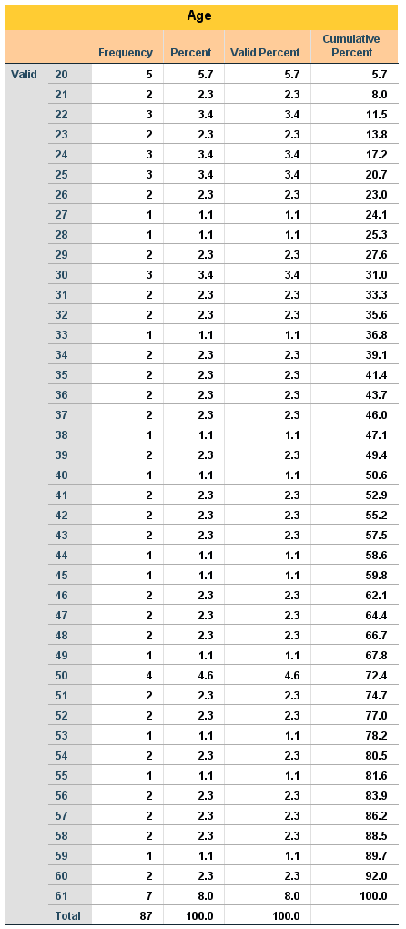
Statistical Analysis
Page 7
Statistical Table of Age Column.
Starting from table on left, our findings from calculation was: In group age between 20-39 we had 43 participants. From table on the right, the number of participants in age between 40-61 equals to 44.
Insights: This survey was positively received in younger and older generation.

Slide 9
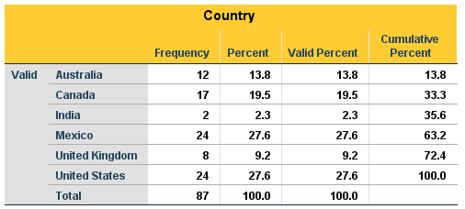
Visual and Statistical Analysis
Page 8
Frequency of participant per Country.
Moving forward, on Figure 3 we have clear indication that most of the surveyed was from United States and Mexico with score of 24. Followed by Canada with score of 17, after Australia with 12 participants, and last two we have United Kingdom with score of 8 and last India with score of 2. We can confirm this with Statistic Table provided.
Fig. 3

Slide 10
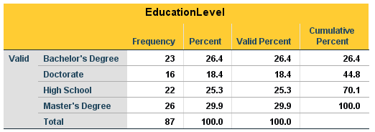
Visual and Statistical Analysis
Page 9
Frequency of participant per Education Level.
Continuing to another Figure, we got information related to Education level of each surveyed. Participant with Master’s Degree has the highest frequency with score of 26, followed by Bachelor’s Degree with 23 cases, just after High School which is equal to 22 and lastly Doctorate with score of 16 as shown on Figure number 4, and confirmed with Statistical Table.
Fig.4

Slide 11
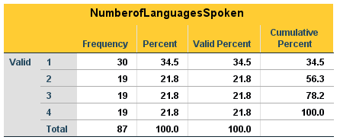
Visual and Statistical Analysis
Page 10
Frequency of participant per Nr of Languages Spoken.
On to Figure number 5, we can see from our participant the frequency of languages spoken. Survey had 4 options to be chosen from. As we can see on our figure most of the surveyed, speaks 1 language ( 30 cases ). For bilingual, trilingual and quadrilingual we have same number of cases which is 19 per each option.
Fig. 5

Slide 12
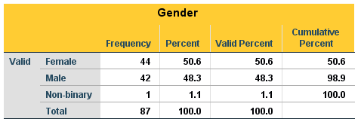
Visual and Statistical Analysis
Page 10
Frequency of participant per Gender.
For our 6th Figure, we have frequency per Gender of surveyed. As Figure and Statistical Table indicates, there was almost equal amount of Female and Male gender interested in survey and, we have one case for Non-binary. There was 44 Females and 42 Males who took part in this survey.
Fig. 6

Slide 13
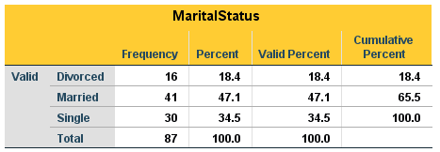
Visual and Statistical Analysis
Page 11
Frequency of participant per Marital Status.
Approaching the end of this part of presentation, we are looking at Marital Status column. In our survey we got 41 Married, 30 Single people and 16 Divorced.
Fig. 7

Slide 14
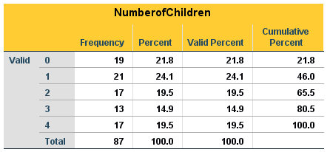
Visual and Statistical Analysis
Page 12
Frequency of participant per Nr. of Children.
For our last step we got Figure nr. 8 which illustrates Number of Children per participant. The highest frequency is people with 1 children with score of 21 followed by 0 children with score of 19. After we have 2 rows with the score of 17 for 2 children and 4 children, and last 3 children with score of 13.
Fig. 8

Slide 15

Summary of our Findings.
Page 11
PART 3

Slide 16

Recommendations
Page 12
PART 3

Slide 17
Thank you for your time and attention !

